Slide 1
CRIME PREDICTION ANALYSIS
Presented by
Nishat Tabassum- 22071D5802
T Bindhu Bhargavi –22071D5803

Slide 2
CONTENTS
Introduction
Bliss of Automation
Use of Dataset
Data pre-processing
Visualization
Time Series Forecasting
Classification
Clustering
Crime mapping
Conclusion

Slide 3
INTRODUCTION
Crimes such as drug related offenses, burglaries, and much more can be predicted through crime patterns within a neighborhood or community to better prevent crime in the future or locate resources in much-needed areas to handle crime as it occurs. The main objectives of crime analysis include:
1. Extraction of crime patterns by analysis of available crime and criminal data
2. Prediction of crime based on spatial distribution of existing data and anticipation of crime rate using different data mining techniques
3. Detection of crime.

Slide 4
Why Crimes ShouldBe Predicted?
Crimes are a common social problem affecting the quality of life and the economic growth of a society. Crimes could occur every where, it is common that criminals work on crime opportunities they face in most familiar areas for them. It is considered as an essential factor that determines whether people move to a new city and what places should be avoided when they travel . By providing a data mining approach to determine the most criminal hotspots and find the type, location and time of committed crimes, we hope to raise people’s awareness regarding the dangerous locations in certain time periods. By hand, these are arduous tasks but AI categorization shifting through massive amounts of visual data along with ML behavior scripts AI/ML algorithms can eliminate human errors especially in witness identification and therefore increasing arrest accuracy.

Slide 5
BLISS OF AUTOMATION
Steps:
Data Collection
Data Preparation
Choosing a Model
Train the Model
Evaluation of the Model
Parameter Tuning
Making Predictions

Slide 6
Cont…
Automation is the technology by which a process or procedure is performed with minimal human assistance.
By simplifying change through automation, you gain the time and energy to focus on innovation.
AI/ML are used to find locations or areas where most of the criminal activities takes place. AI/ML algorithms can eliminate human errors therefore increasing arrest accuracy.” Predictive policing” is the practice of identifying the date, times and
locations where specific crimes are most likely to occur, then scheduling officers to patrol those areas in hopes of preventing crimes from taking
place, therefore keeping neighbourhoods safer.

Slide 7
USE OF DATASET
Prediction process
Data gathering
Classification / Clustering
Prediction / Forcast

Slide 8
Cont…
The data which we have used in this model has been collected from Toronto Police Service- Public safety portal. This collected data can be used to extract meaningful information which can help both the police department and the public to maintain safe surroundings. Identifying crime and predicting dangerous hotspots at a certain time and place could provide a better visualization for both public and authorities. In this dataset we have columns such as- Occurrence date, month, reporting date , Neighbourhood, type of offence, MCI (or Major Crime Indicators). This would help in clearly showcasing which neighbourhood are dangerous and require more focus of police agencies. It would also supplement to the general public’s knowledge for their own well-being and safety. We have used several time series forecasting along with classification and clustering algorithms to validate the results.

Slide 9
DATA PRE-PROCESSING
There were many duplicates as well as there were columns like X,Y coordinates , NeighborhoodID, ReportDayOfweek, etc which were not that relevant for predictions and clustering so we had to drop those columns. Using the data after dropping these columns we have done various visualizations using grouping techniques. We had to factorise various independent and dependent variable for classification. Also,OneHotEncoder() was used to all the X variables for input into the classification model. Also we, have considered those crimes which took place after December 2016 as before that there were not sufficient data.

Slide 10
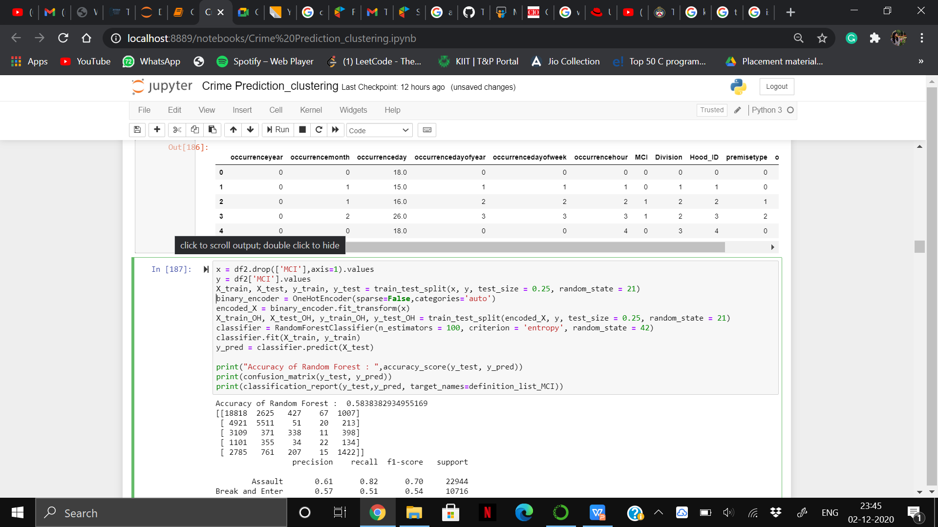
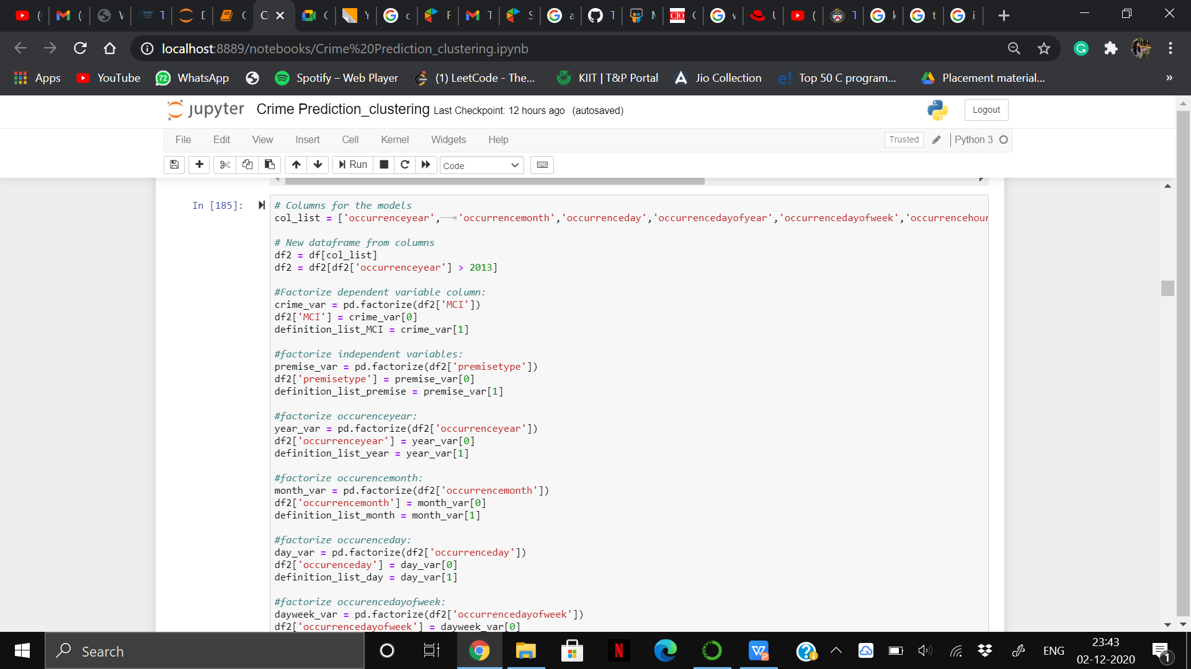
Cont..

Slide 11
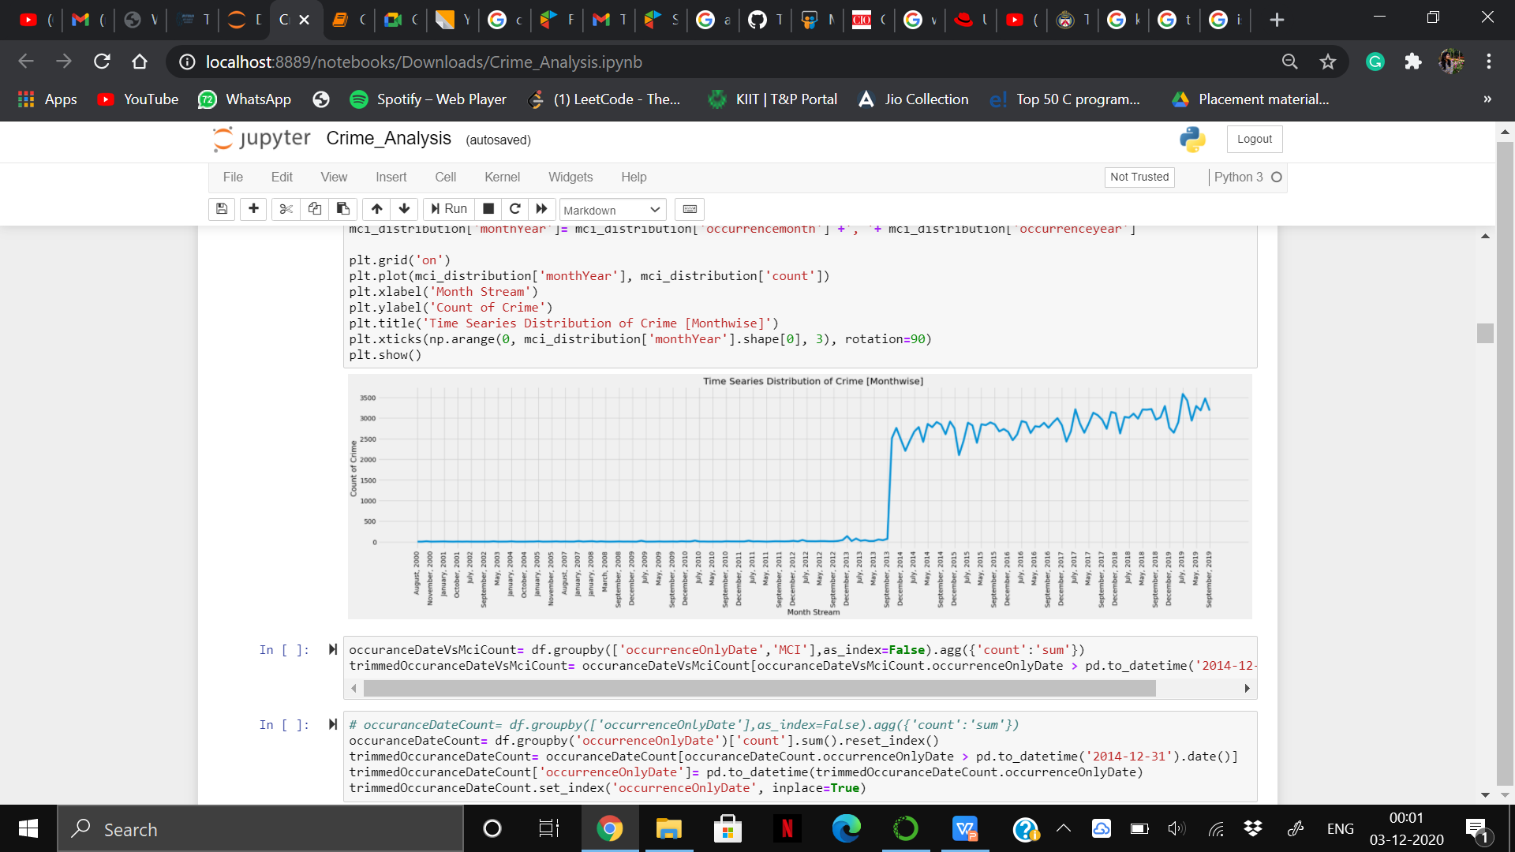
Fig: Time Series Distribution of Crime.

Slide 12
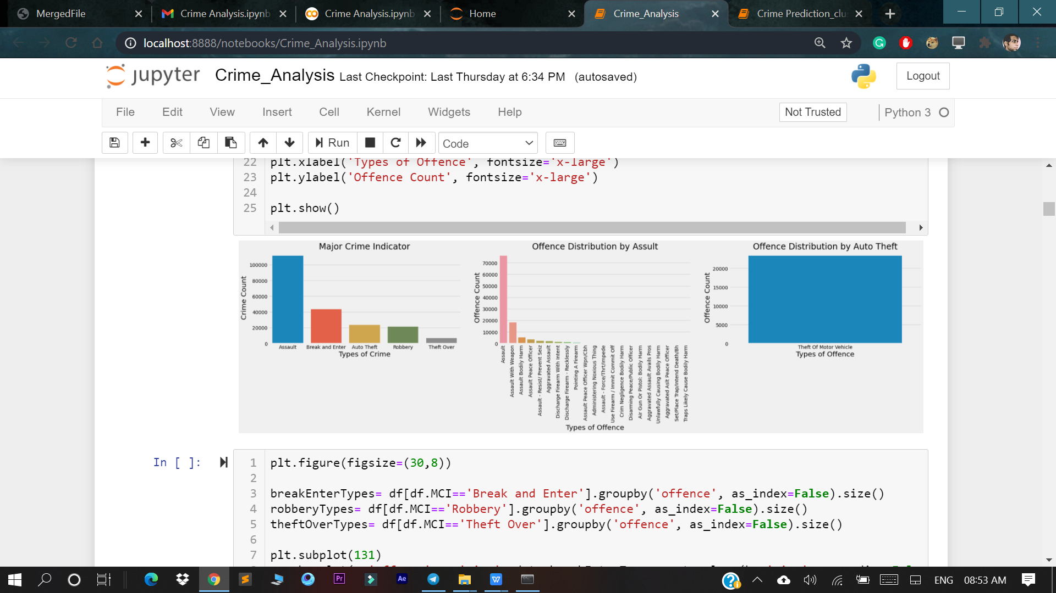
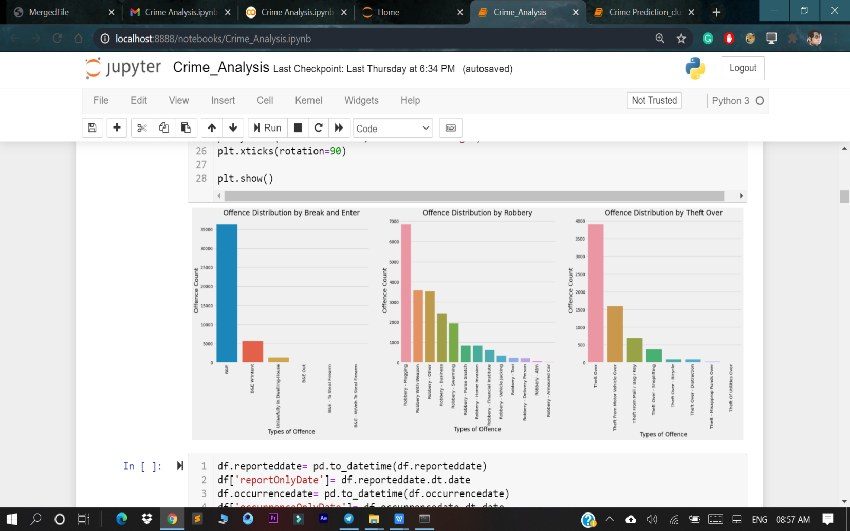
VIZUALIZATION

Slide 13
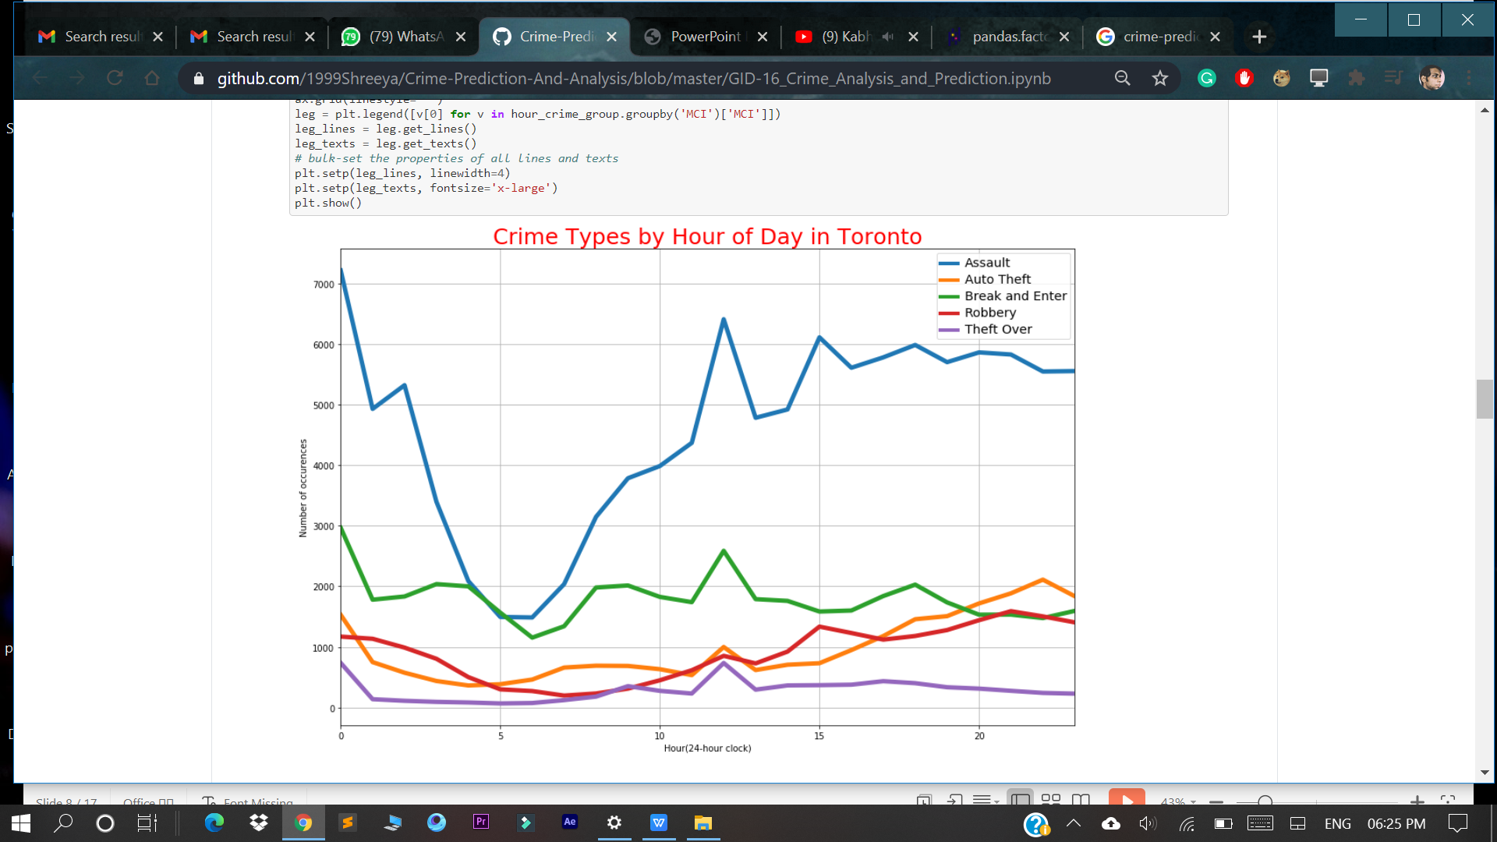
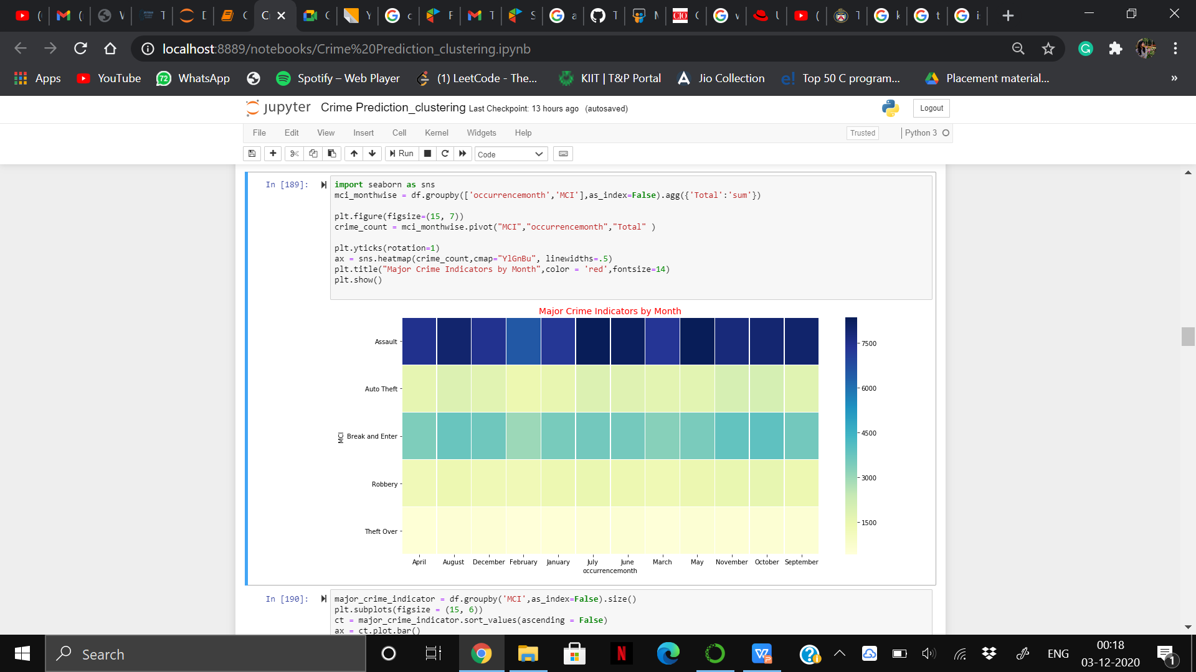
VIZUALIZATION

Slide 14
TIME SERIES FORCASTING
ARIMA Time Series Forecasting: A popular and widely used statistical method for time series forecasting is the ARIMA model. ARIMA is an acronym that stands for Autoregressive Integrated Moving Average. It is a class of model that captures a suite of different standard temporal structures in time series data.
AR: Autoregression. A model that uses the dependent relationship between an observation and some number of lagged observations.
I: Integrated. The use of differencing of raw observations (e.g. subtracting an observation from an observation at the previous time step) in order to make the time series stationary.
MA: Moving Average. A model that uses the dependency between an observation and a residual error from a moving average model applied to lagged observations.
SARIMA for Time Series Forecasting: An extension to ARIMA that supports the direct modelling of the seasonal component of the series is called SARIMA.

Slide 15
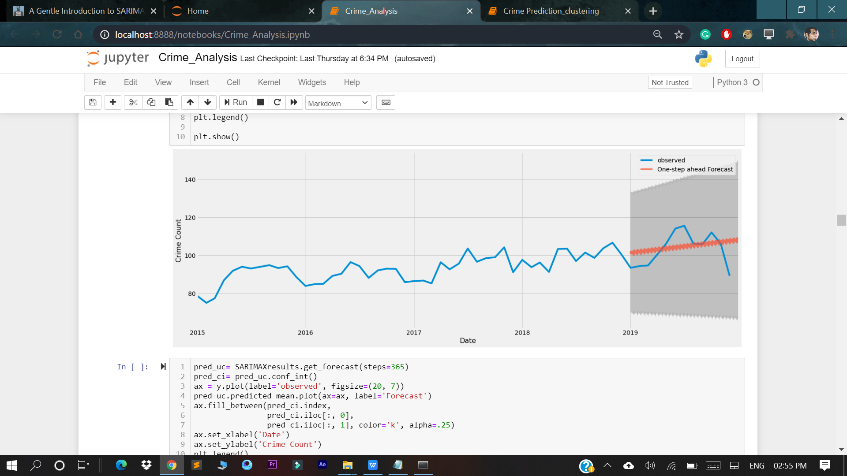
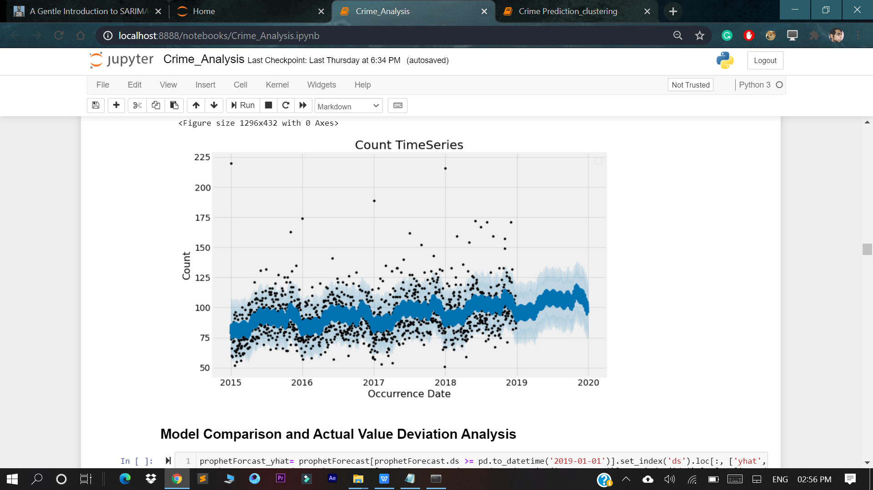
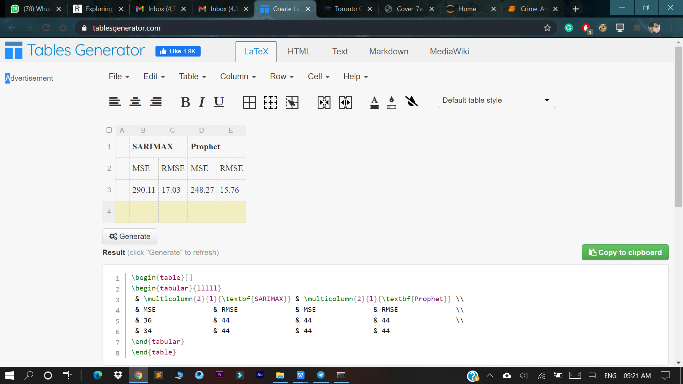
SARIMAX FORECASTING
PROPHET TIME SERIES FORCASTING
VERIFICATION TABLE

Slide 16
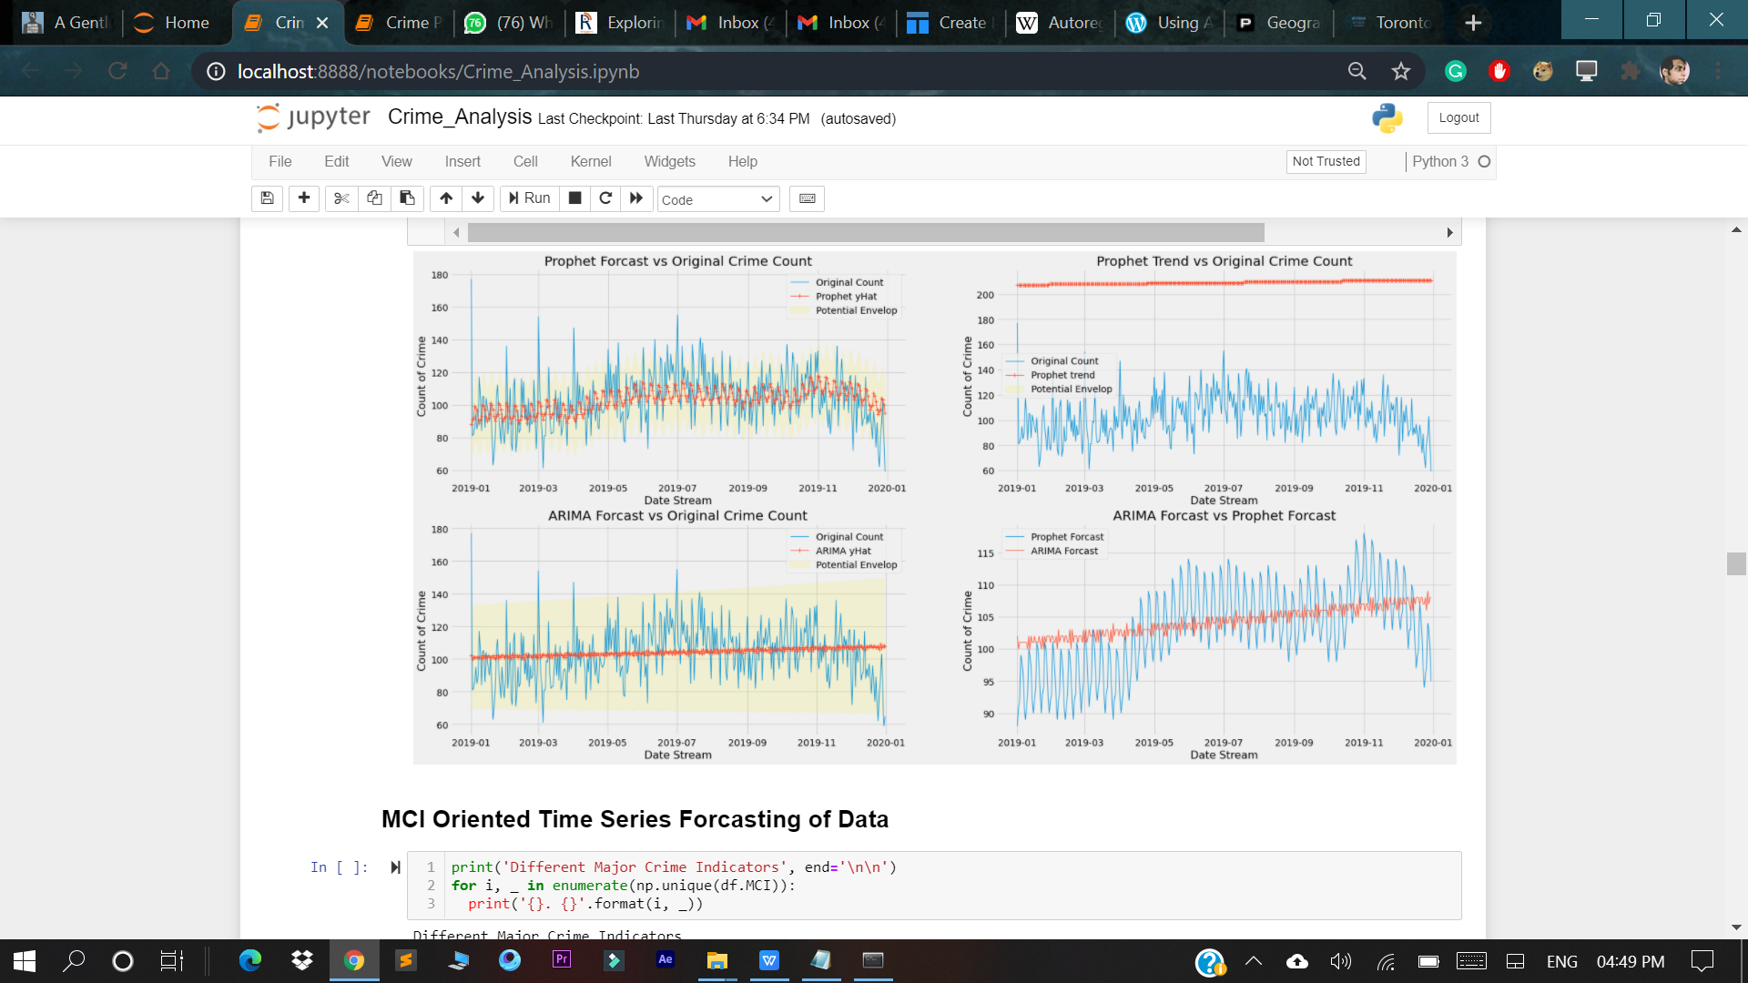
Differences Between The Original And The Predictive Model Plotted In Graphical Manner

Slide 17
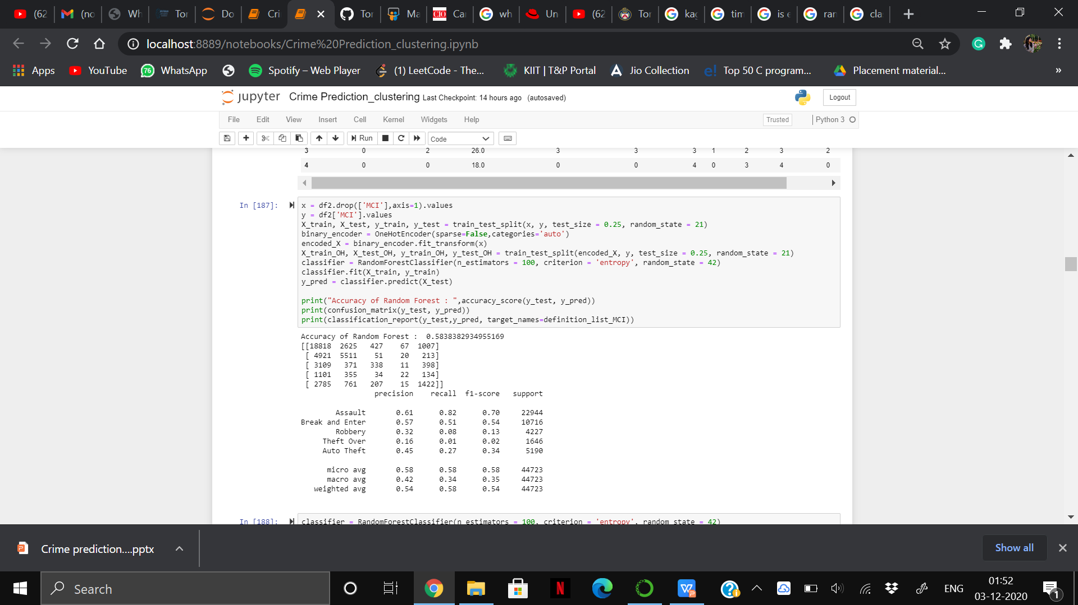
CLASSIFICATION
Classification refers to a predictive modelling problem where a class label is predicted for a given example of input data. In this project, we have used Random Forest Classification algorithm which operate by constructing a multitude of decision trees at training time and outputting the class that is the mode of the classes or mean/average prediction of the individual trees and have got an accuracy of 58.38%.

Slide 18
CLUSTERING
Clustering, is an unsupervised machine learning task. It involves automatically discovering natural grouping in data. In this model we have used K-Means Clustering technique that aims to partition n observations into k clusters in which each observation belongs to the cluster with the nearest mean (cluster centres or cluster centroid), serving as a prototype of the cluster. We have chosen Elbow method to determine number of clusters in the dataset. Also, we have done visualization of clustered data and silhouette plot for various clusters and displayed Crime neighbourhoods by K-Means.

Slide 19
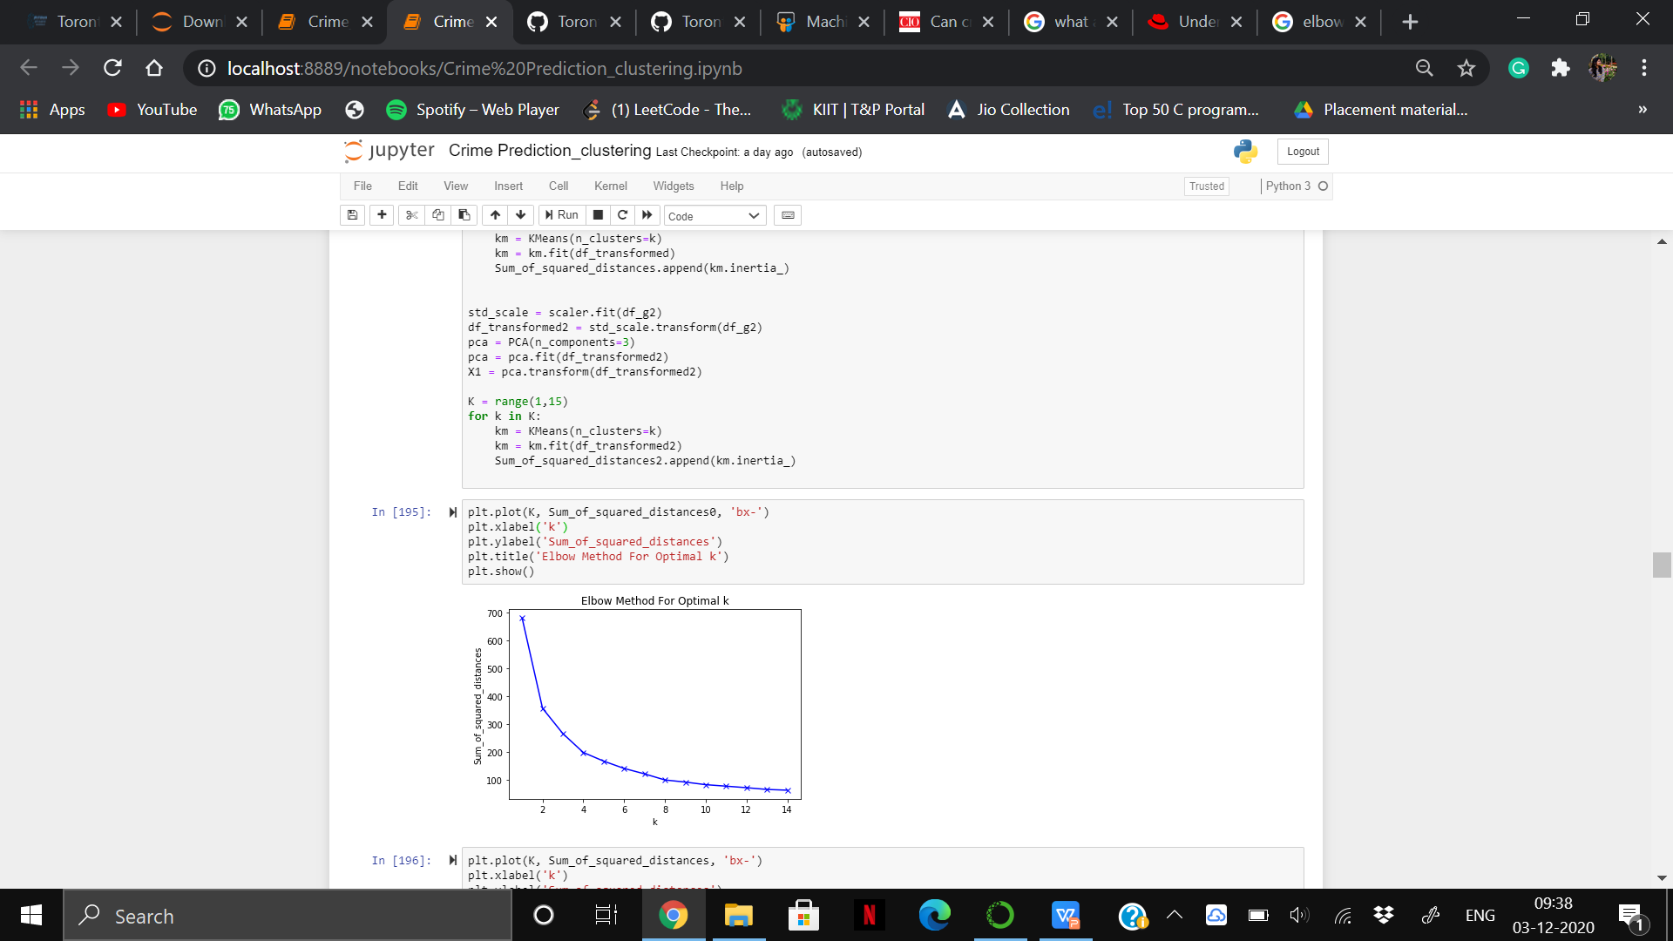
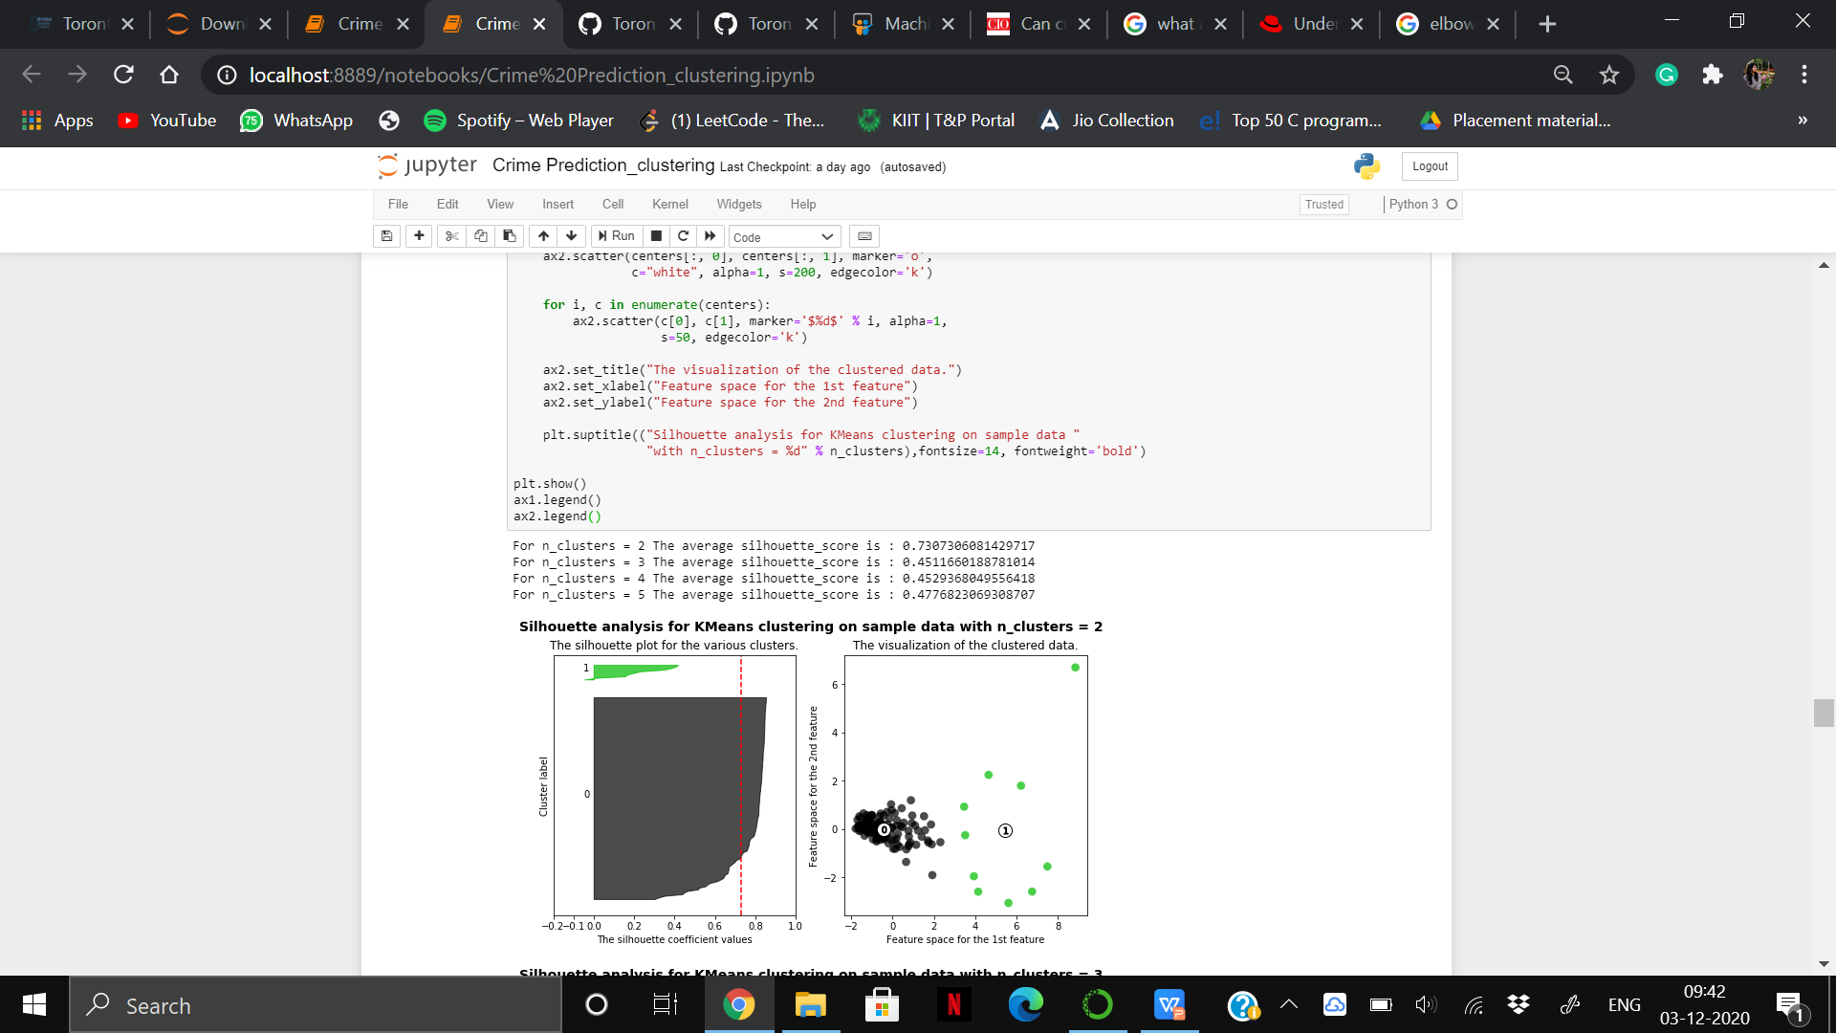
Cont..

Slide 20
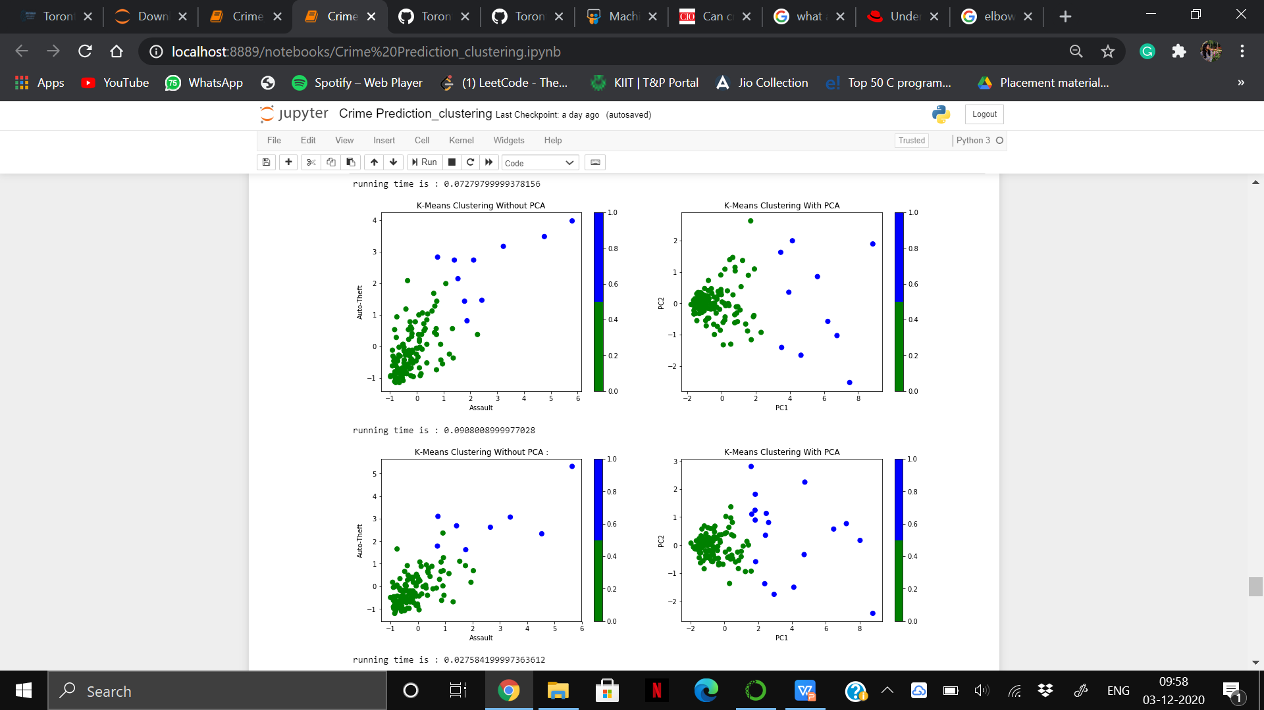
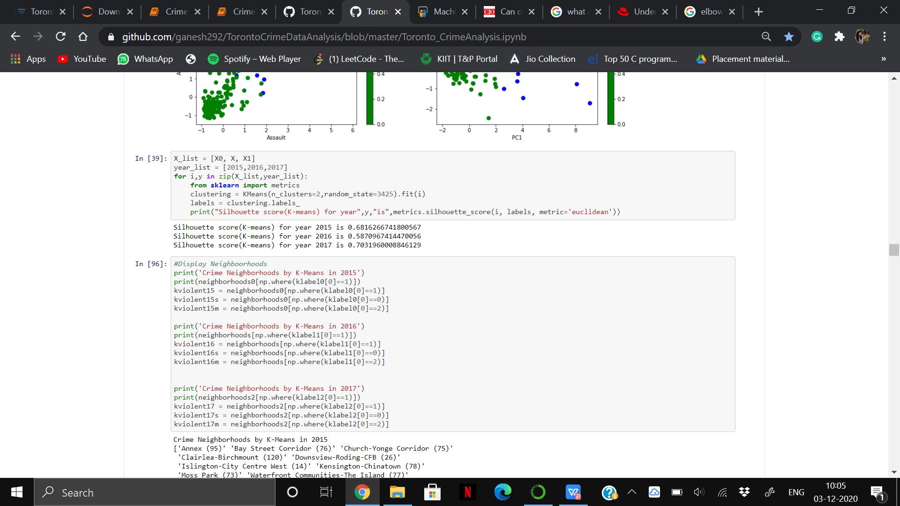
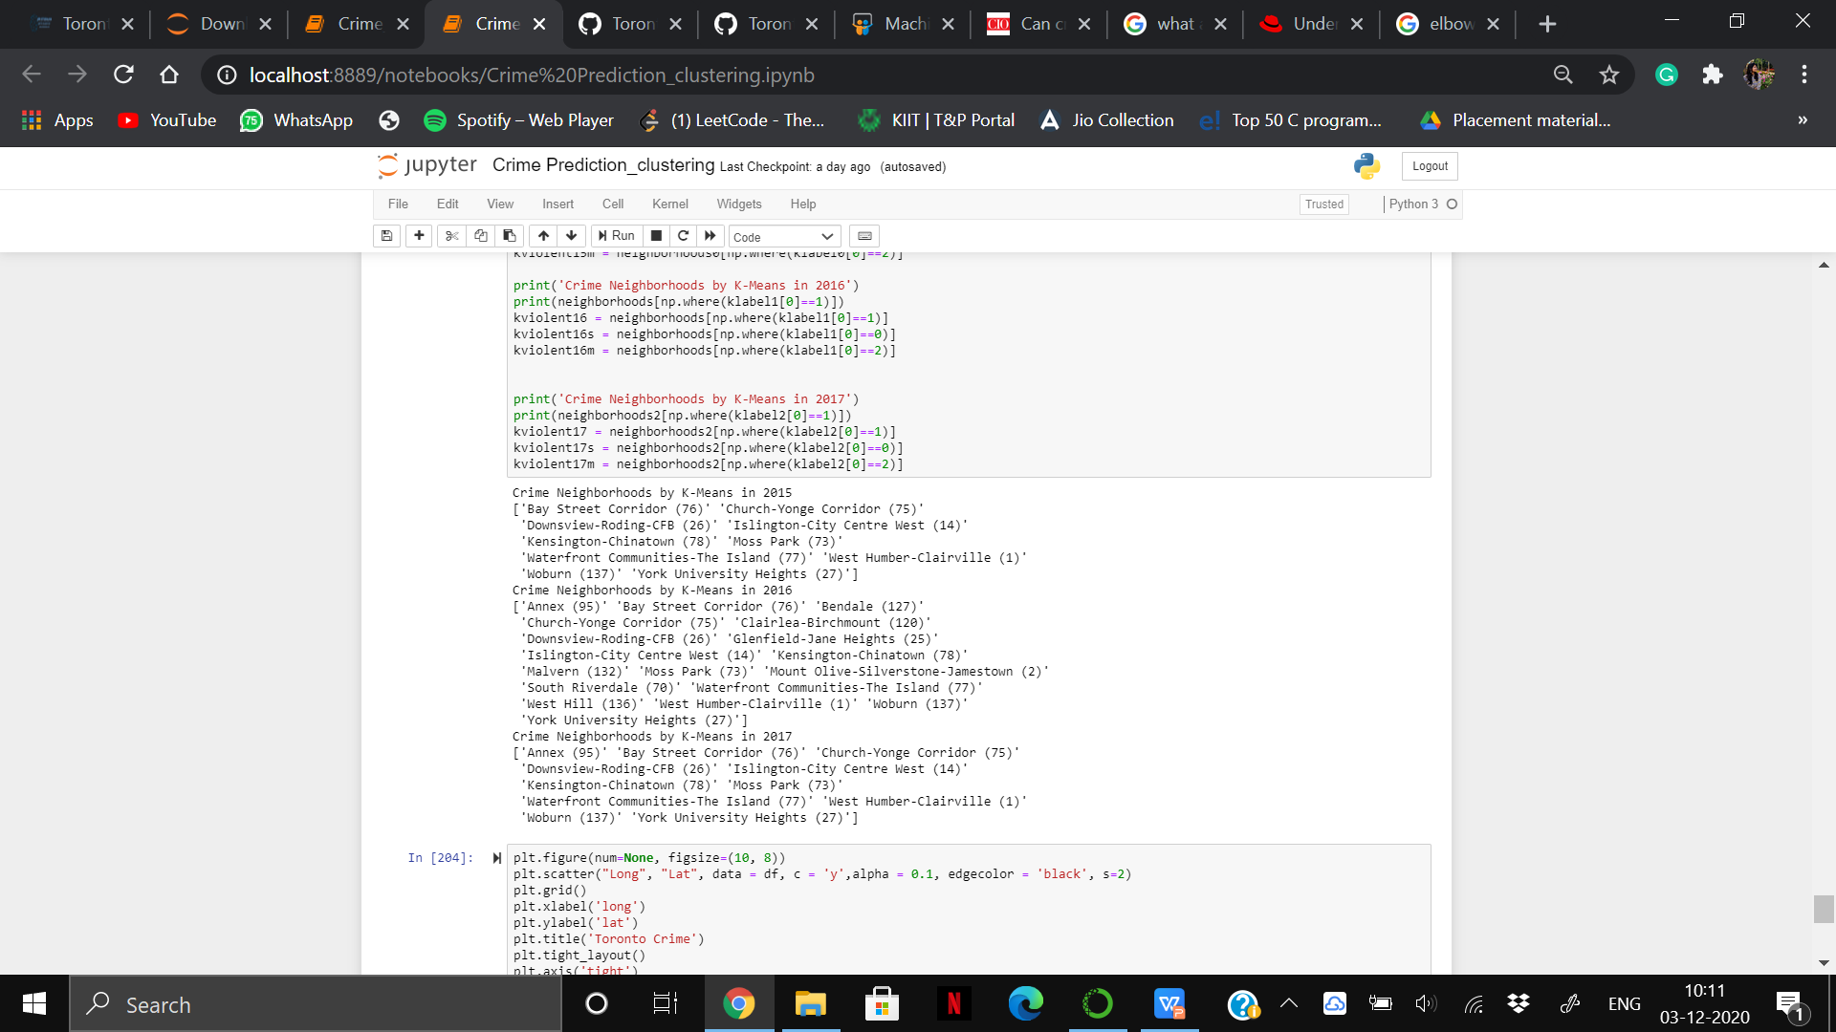
We have done the clustering twice one with PCA and one without PCA. Using PCA we have got good clusters and also running time was quite less.
Silhouette score of different clusters
Neighbourhoods where crime occurred the
most in consecutive three years

Slide 21
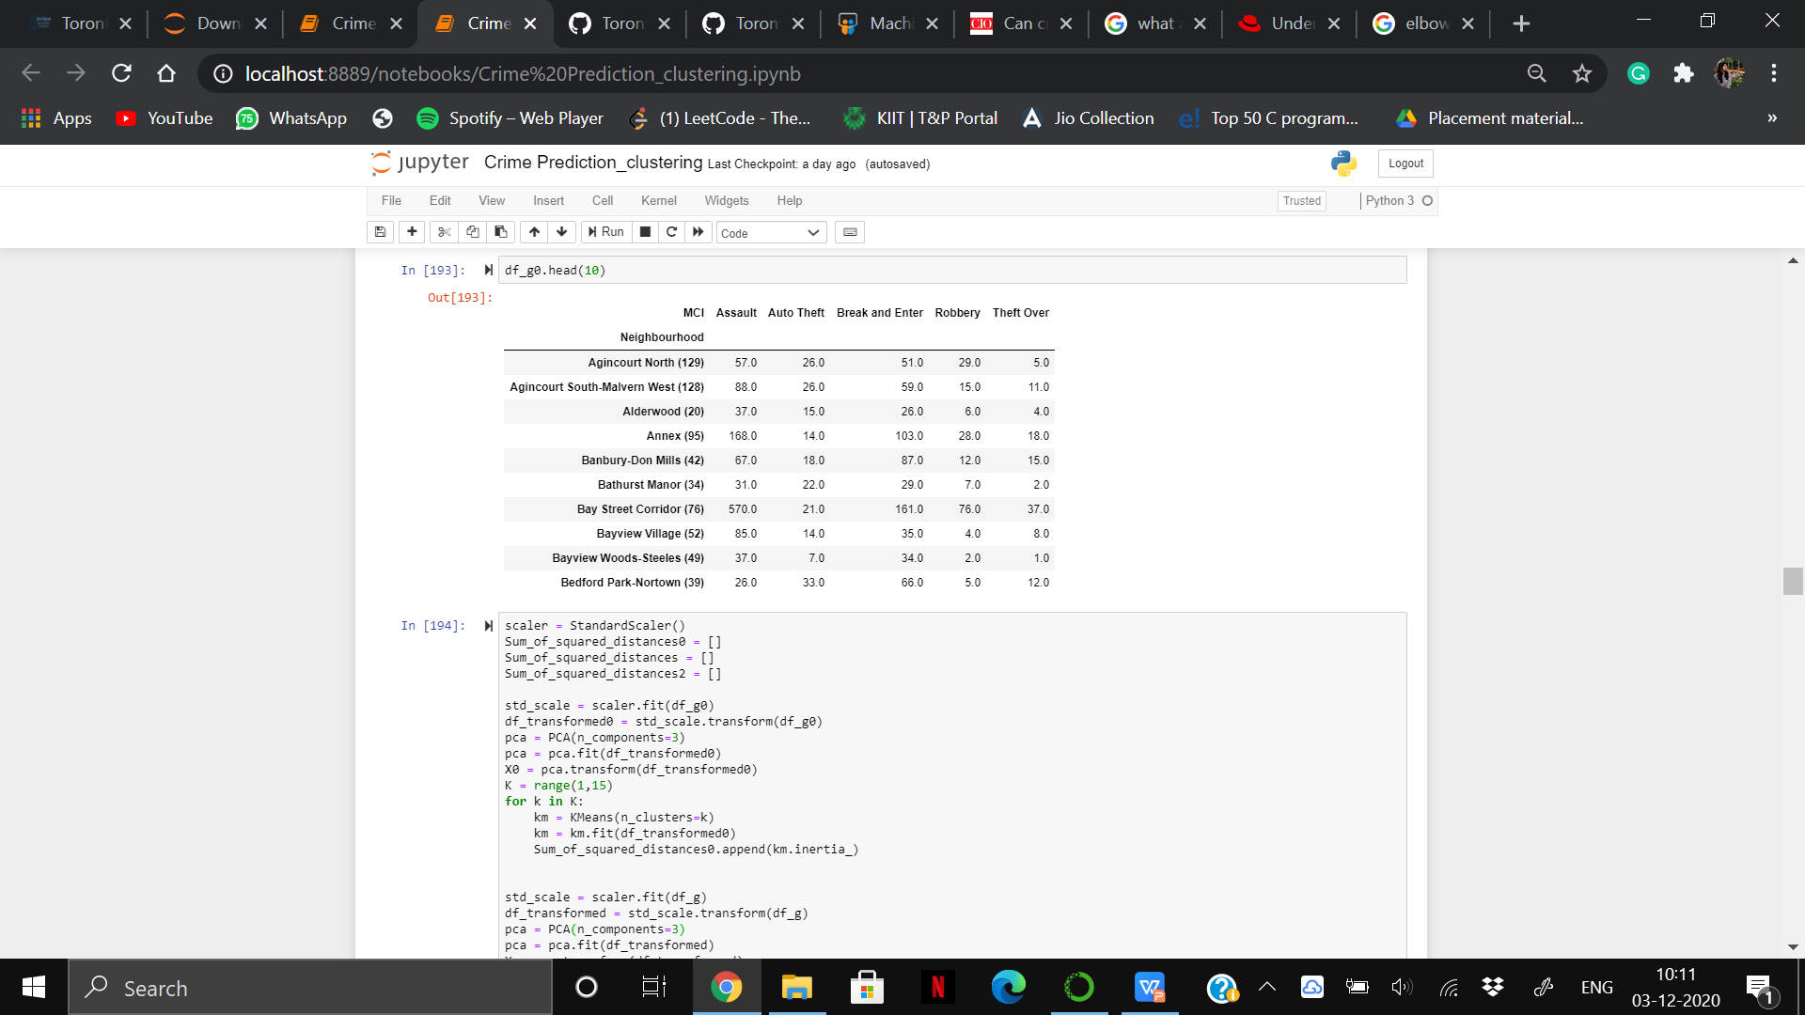
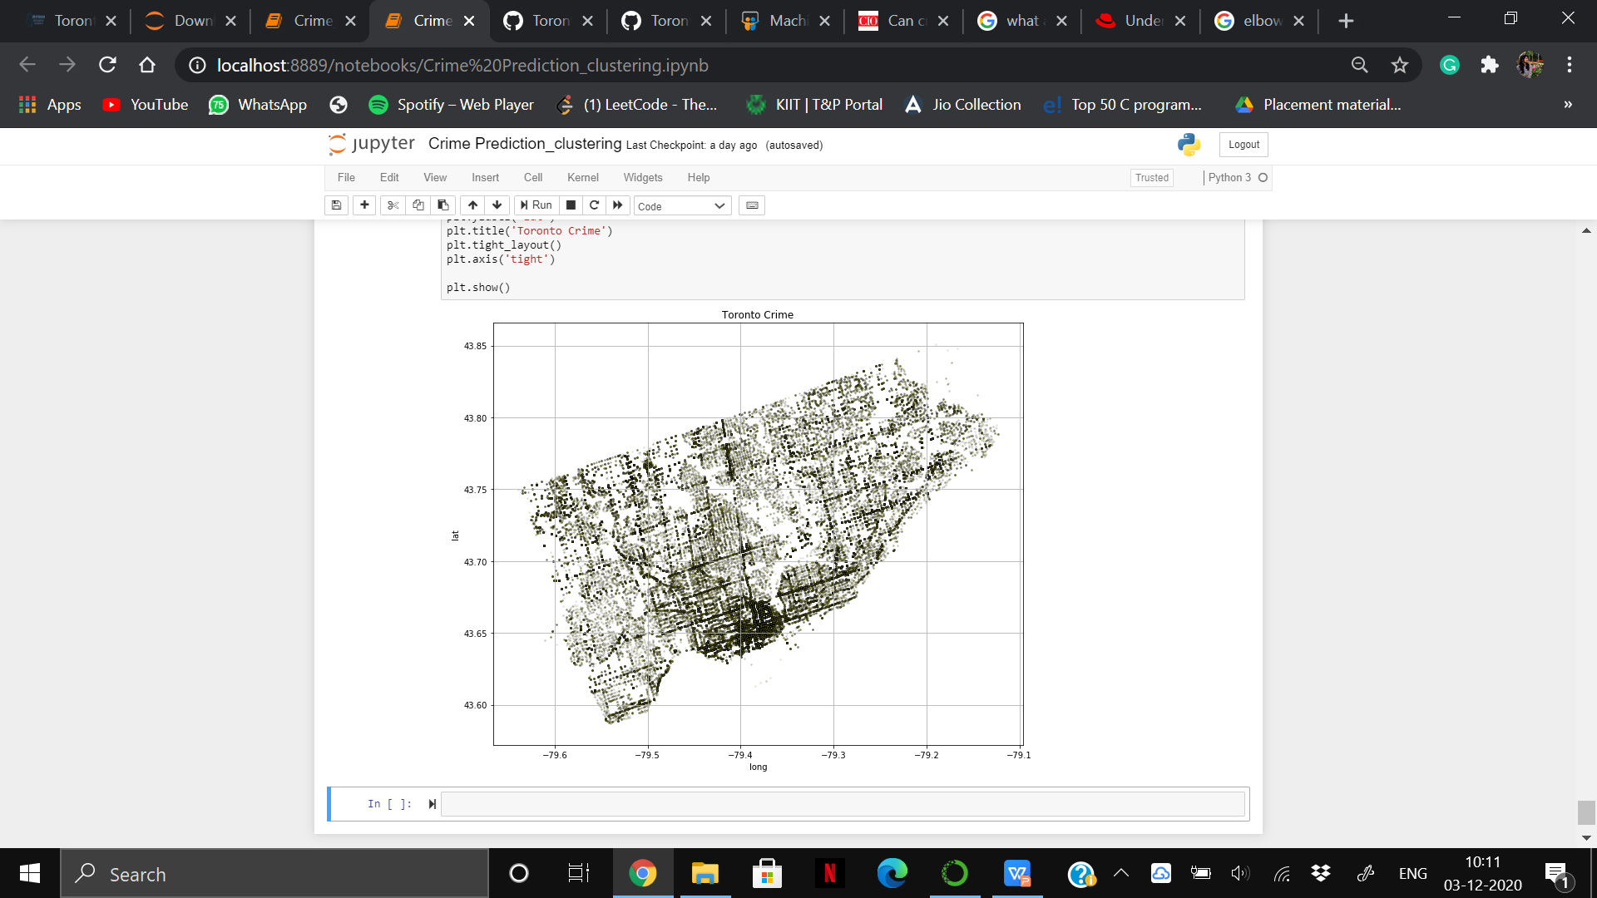
CRIME MAPPING
Result after grouping Neighbourhood with MCI
Places of high-density of crime

Slide 22
CONCLUSION AND FUTURE WORK
The spatial analysis of crime in the city of Toronto demonstrates interesting relationships between police-reported crime and neighborhoods associated with them. Outcomes of this analysis have shown how certain neighborhood characteristics are related to a higher degree of crime rates. This study will aid in identifying crime and predicting dangerous hotspots at a certain time and place and in proper planning and safety measures to stop the antisocial activities from happening in the community.In the future, we can find people or groups who have committed the crime and find reasons behind these activities.
Also, we would like to predict future crime spots which will include a greater number of places/ cities. Thus, providing a broader aspect of criminal activities. While there is little reason to believe that the crime rate will increase dramatically in the first decade of the 21st Century, given the anticipated increases in the globalization, sophistication, and organization of crime, one may conclude that the impact of crime on Western societies may be more severe than the one witnessed under a similar rate of crime in the past. The goal of any society shouldn’t be to just catch criminals but to prevent crimes from happening in the first place.

Slide 23


